Slide 1
INDIAN PREMIER LEAGUE 2008-2020
DATA SOURCE : https://www.kaggle.com/datasets/patrickb1912/ipl-complete-dataset- 20082020?select=IPL+Ball-by-Ball+2008-2020.csv
This Complete Dataset is about Indian Premier League from 2008 to 2020 , using this Data came up with the valuable insights in a Dashboard
The Dataset contained in two csv file has 18 Columns ,193469 rows and 17 columns , 817 rows respectively.
The columns Dataset has are : id, inning, over, ball, batsman, non_striker, bowler, batsman_run, extra_runs ,total_runs , non_boundary , is_wicket, dismissal_kind ,player_dismissed ,fielder, extras_type,batting_team and bowling_team .

Slide 2
Problem statements:
Winner Team Name vs Season
Purple cap Holder vs Season
Orange cap Holder vs Season
Top 10 Batsman vs Season
Top 10 Bowlers vs Season
Match won based on Toss
Dismissal kind vs Bowlers
Number of Fours vs Season
Number of Sixes vs Season

Slide 3
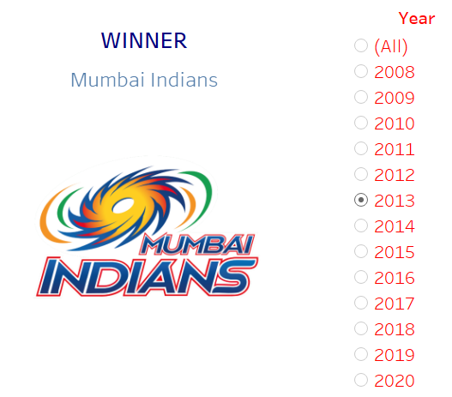
Winner Team vs Season
Insights:
From 2008 to 2020
Mumbai Indians Won 5 times in 2013,2015,2017,2019 and 2020.
Chennai Super kings Won 3 times in 2010,2011 and 2018.
Kolkata knight Riders won 2 times 2012 and 2014

Slide 4
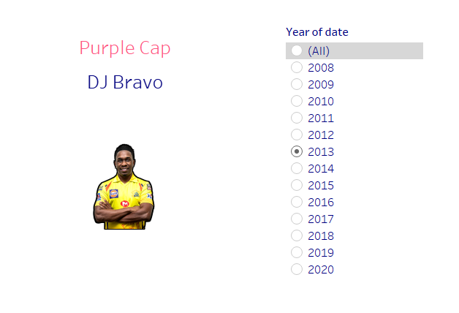
Purple cap Holder vs Season
Insights:
From 2008 to 2020 DJ Bravo and K Rabada won 2 times purple cap
But if we talk about highest number of wickets taken in complete IPL it’s SL Malinga

Slide 5
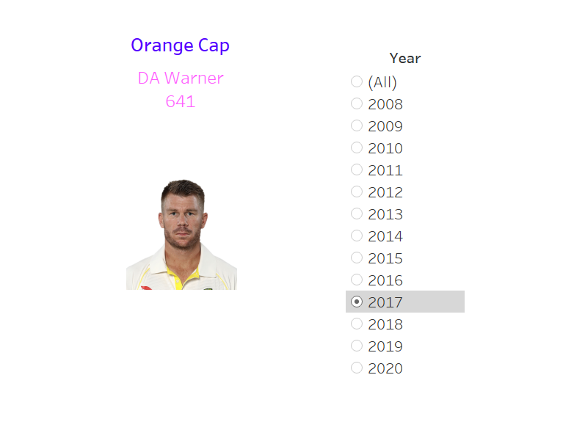
Orange Cap Holder vs Season
Insights:
DA Warner holds Orange cup 3 Times and CH Gayle 2 times in IPL
But in complete IPL Total Highest Run scored by Virat Kohli

Slide 6
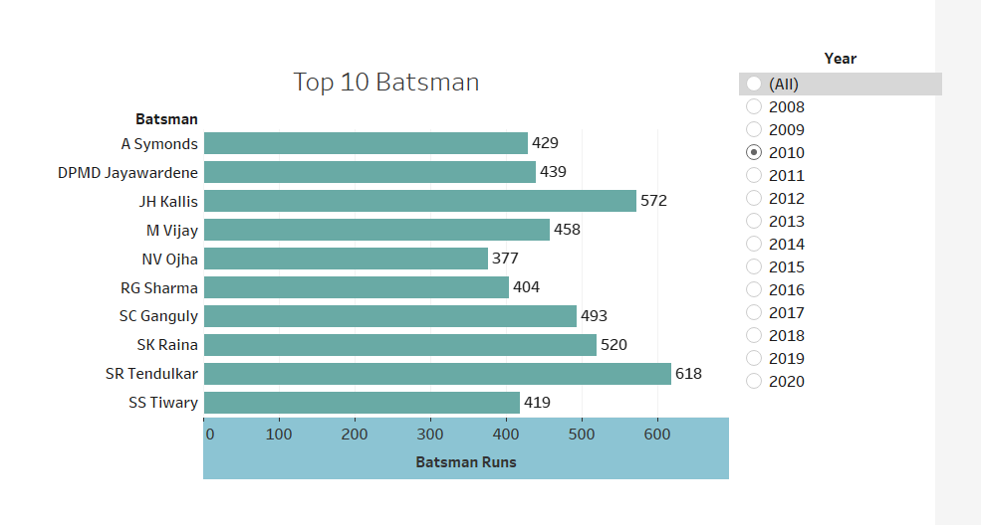
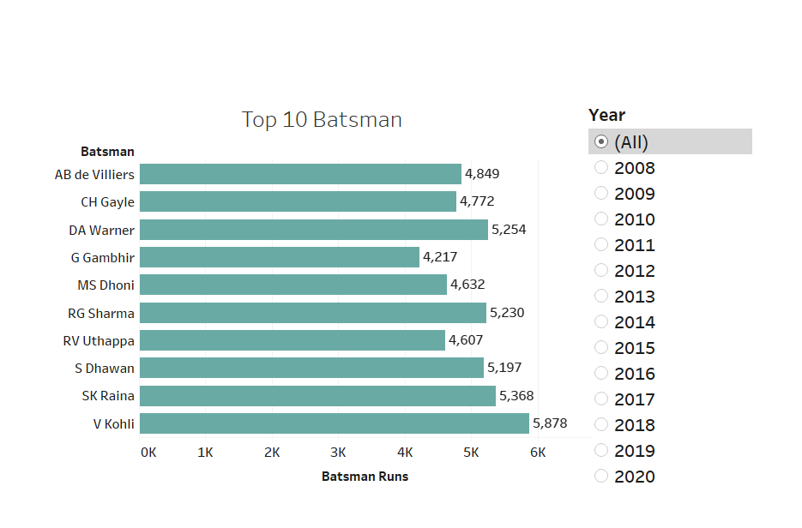
Top 10 Batsman vs Season
Insights:
From 2008 to 2020 if we look separately at seasons the Top batsman are differing every year
So the complete season has Top Batsman are Virat Kohli , SK raina ,DA Warner ,RG Sharma and S Dhawan on top 5 position.

Slide 7
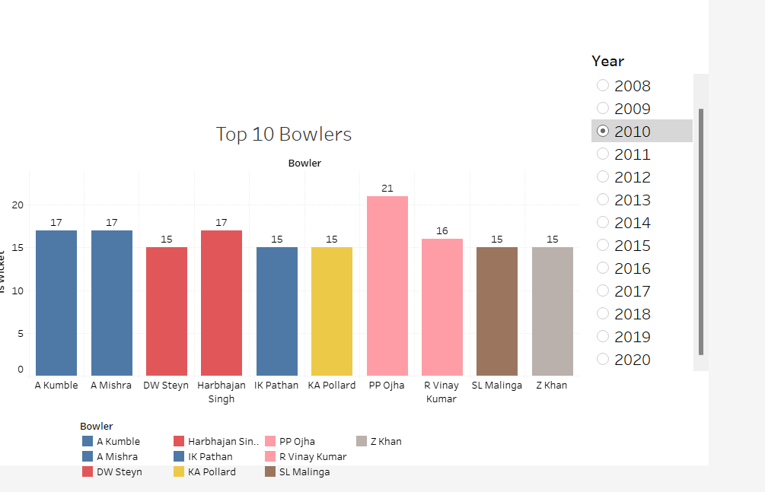
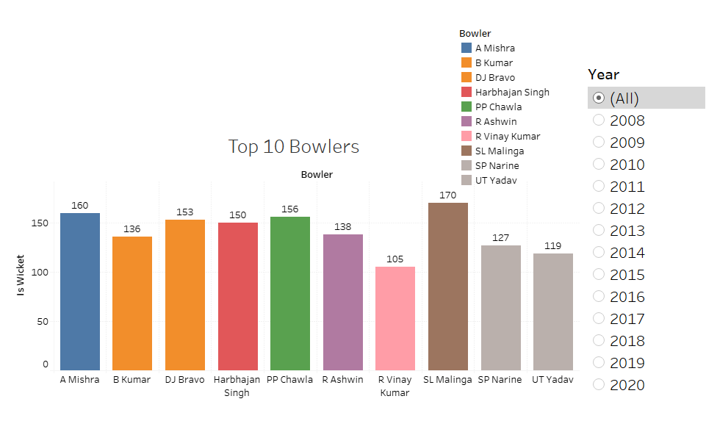
Top 10 Bowlers vs Season
In 2010 the Top Bowler is PP ojha with 21 wickets while in complete season SL Malinga -170, A Mishra-160 and PP Chawla with 156wickets are top 3 Bowlers.

Slide 8
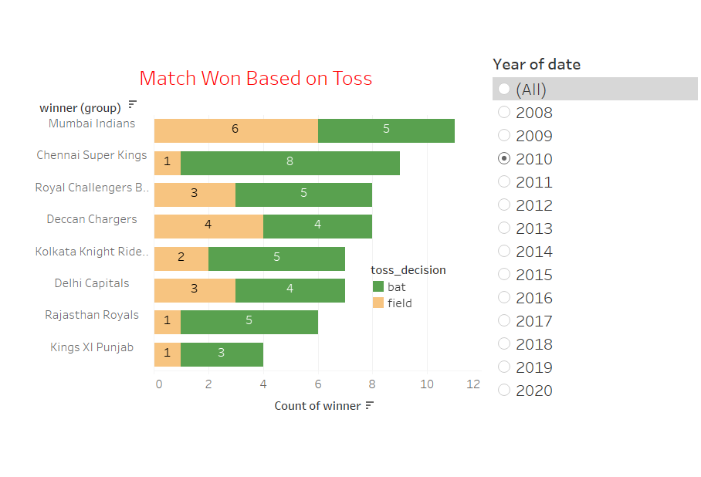
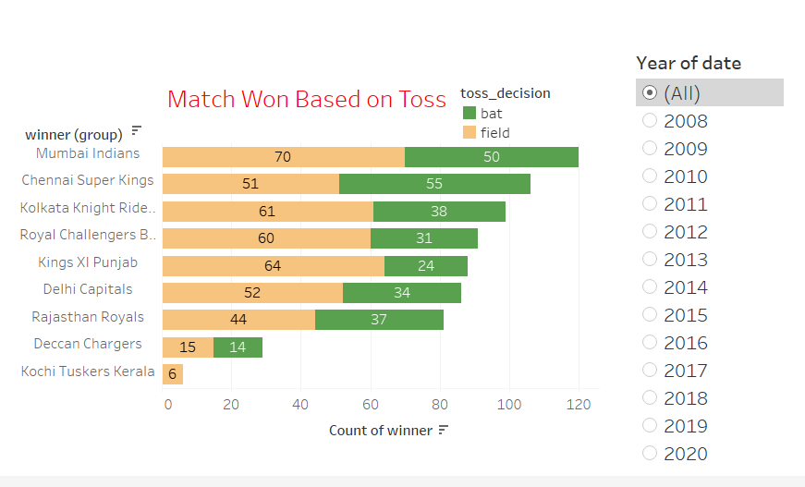
Match won based on Toss vs Season
INSIGHTS :
In 2010 most of the match won by Mumbai Indians and Chennai super Kings respectively .
In complete season from 2008 -2020 highest number of match won by Mumbai Indians ,in bat decision 50 and 70 in field Toss decision respectively.

Slide 9
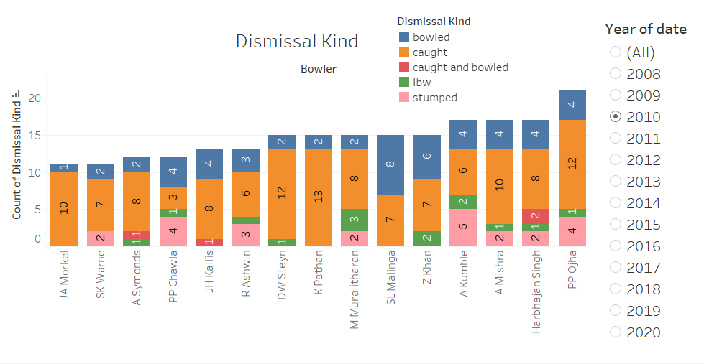
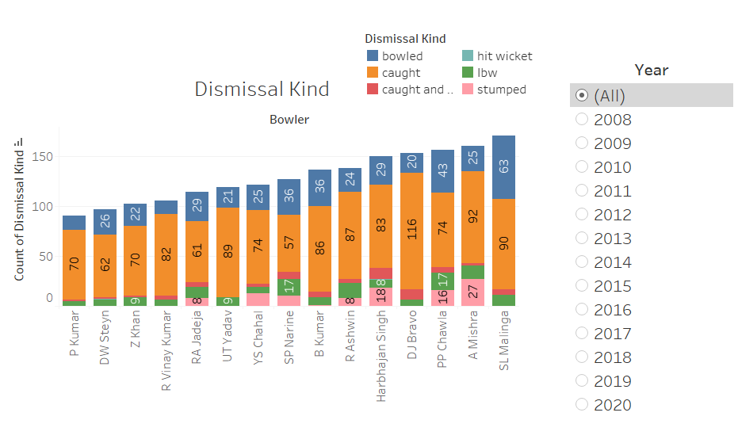
Dismissal kind vs Bowlers
Insights:
In 2010 highest number of wickets are in Caught dismissal kind while in complete season most of wickets are in caught & Bowled kind .

Slide 10
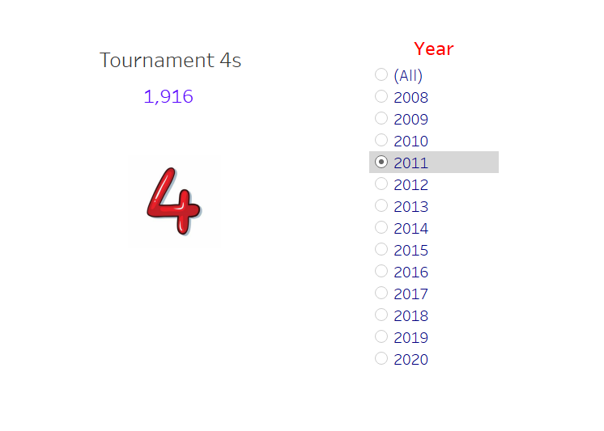
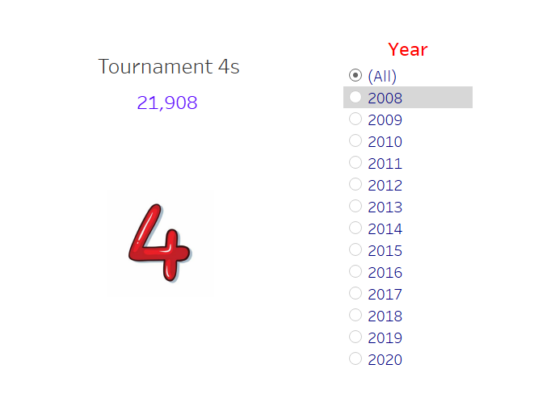
Number pf Fours vs Season
Insights :
As we can see the total fours hit in 2011 is 1916 while the highest in 2013 - 2052 fours .
But if we look at complete season the total number of fours are 21,908 .

Slide 11
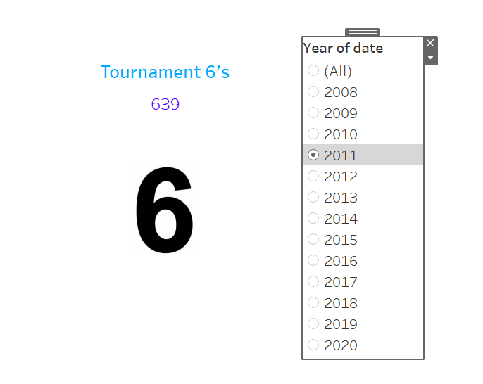
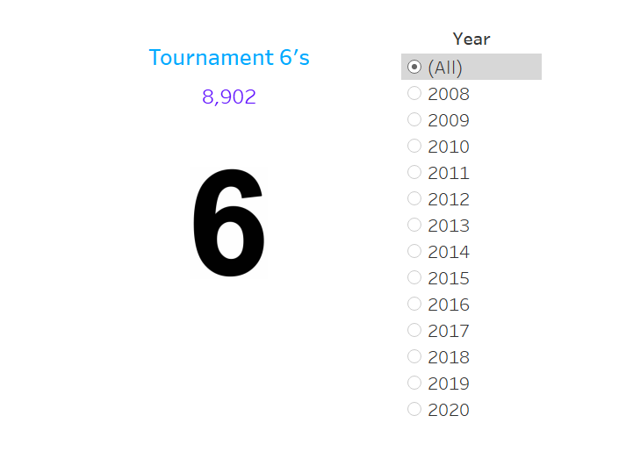
Number of Sixes vs Season
Insights :
As we can see the total sixes hits in 2011 is 639 while the highest in 2018 - 872 sixes .
But if we look at complete season the total number of Sixes are 8,902 .

Slide 12
conclusion
In The complete Season from 2008-2020 , Mumbai Indians is the only five times winner team ,
and the Top batsman are virat kohli , SK raina and DA warner.
while Top bowlers are SL Malinga A mishra and PP chawla .
In The complete Season DJ Bravo & K Rabada won the Purple cap two times While Da Warner won orange cup 3 times
In Toss decision , Mumbai indians won 70 matches on fielding and 50 matches via batting decision
highest number of wicket taken via caught and bowled dismissal kind
in complete season total number of fours hit basman are 21908 and most are from 2013 season
in complete season number of sixes hitby batsman are 8908 and most are from 2018 season

Slide 13
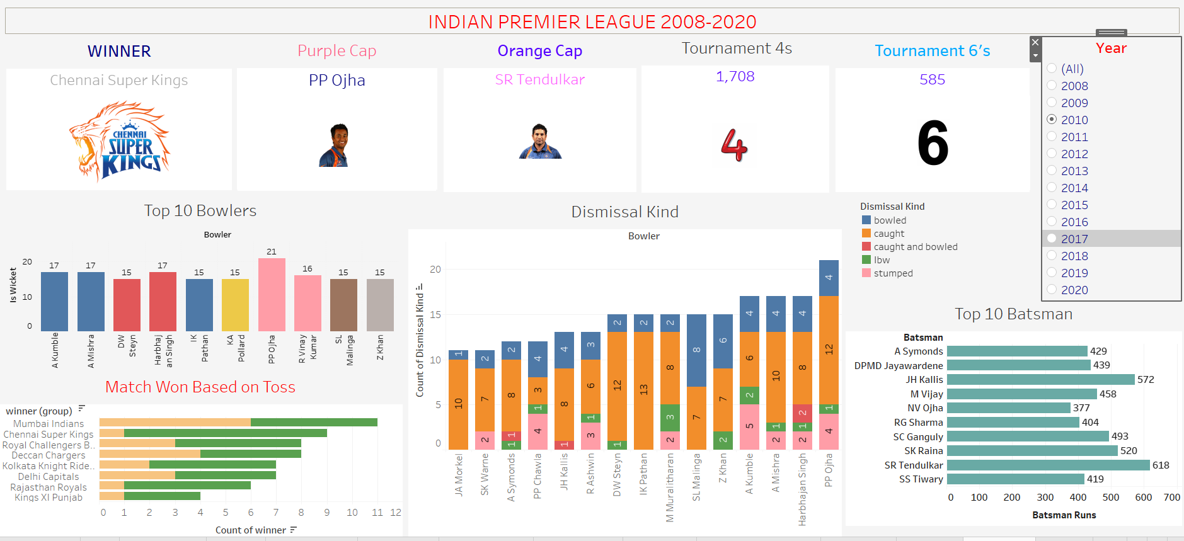
INTERACTIVE DASHBOARD

Slide 14
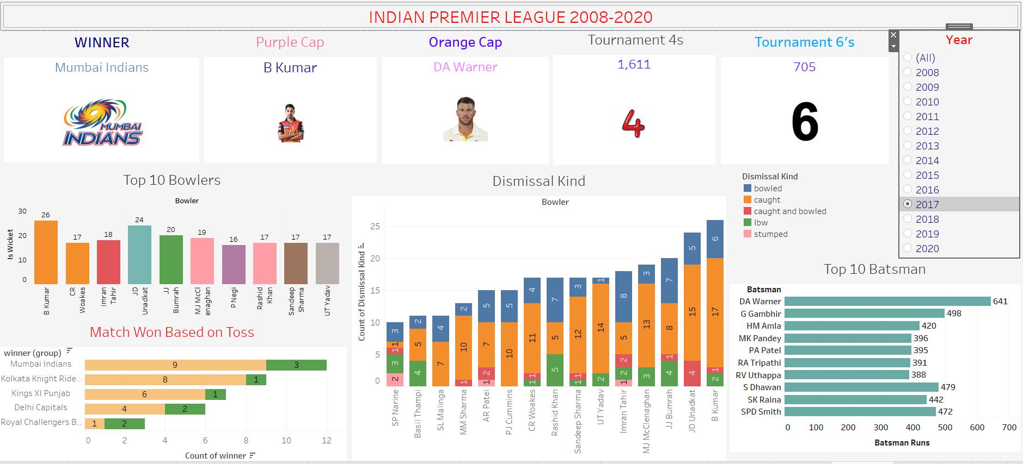

Slide 15
